Slide 1
Prediction of tags for Stack Exchange Questions
A Multi Label Classification Problem
Anudeep Rentala – o11417666
Jayam Malviya – 011435567
Navneet jain – 011419291

Slide 2
Problem Statement
In this problem, we are provided the titles, text, and tags of Stack Exchange questions from six different sites. We have challenged ourselves for tag predictions on untagged questions. The given Data set contains data in six different csv files from different categories namely biology, cooking, crypto, diy, robotics and travel. And a test data csv file. The data format for each document is Title,Text and Tags. For test data, we are given only Title and Text, no tags.

Slide 3
Data Size
 | Train Data | Test Data
No. of Documents | 87000 | 69000
No. of Unique Words | 126000 | 110000
No. of Tags | 4200 | To be predicted

Slide 4
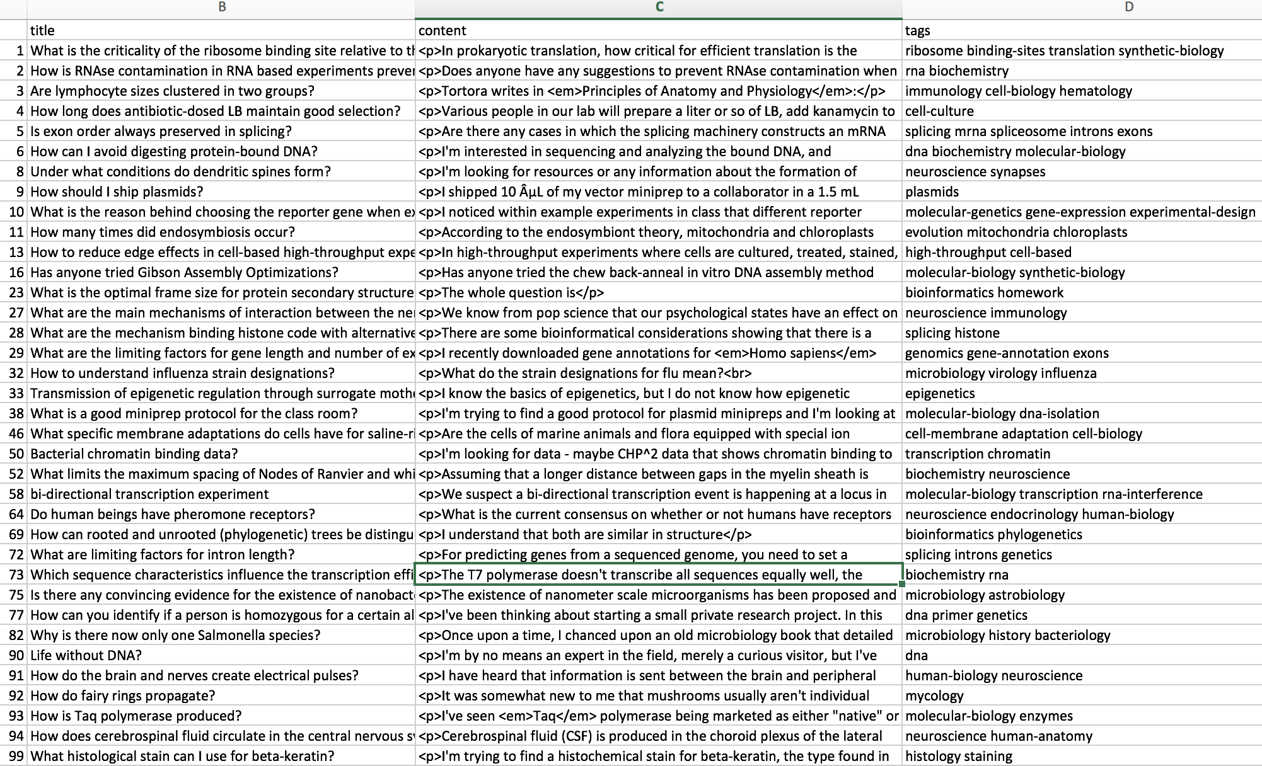
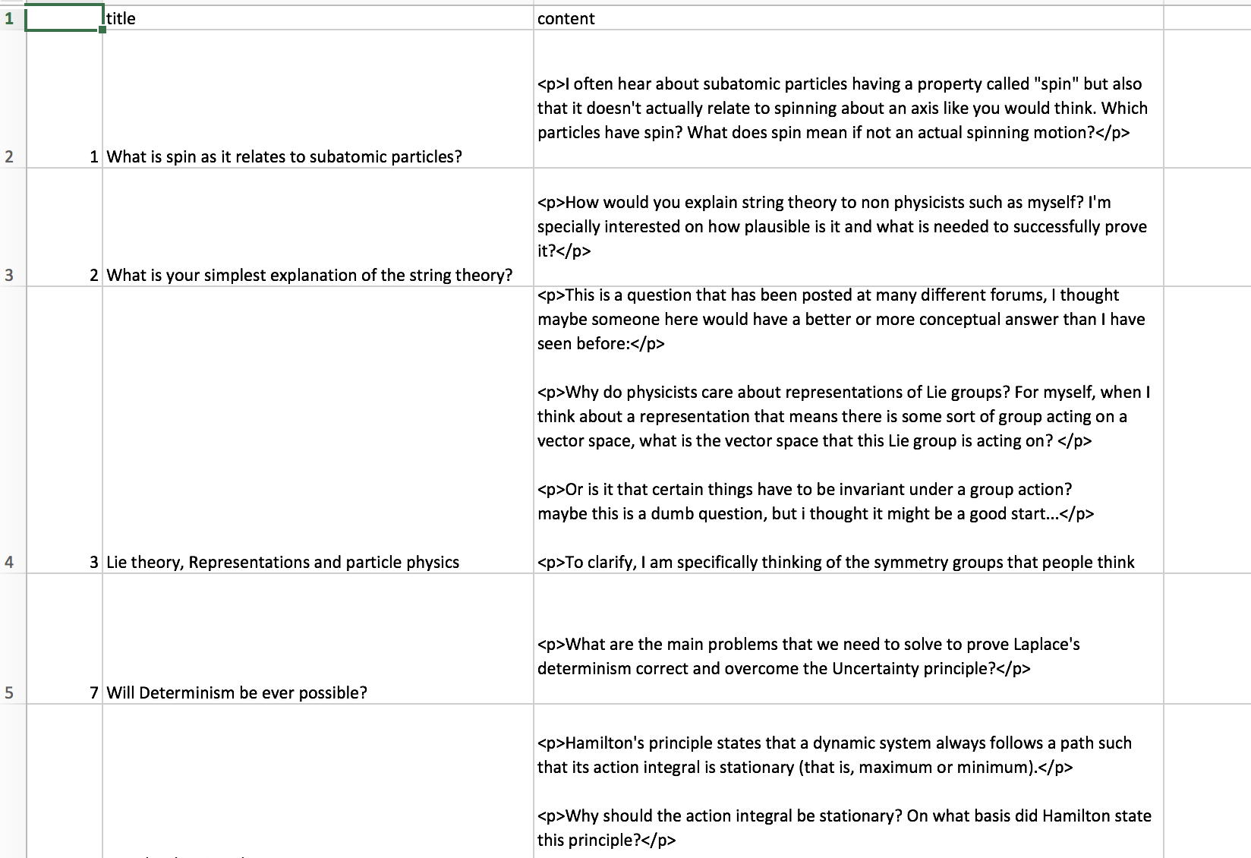
Data Set Snapshots
Train Data Example
Test Data Example

Slide 5
Preprocessing Techniques Used
Removal of HTML tags/elements from the data
Removal of Emoticons/ Smileys from the data
Removal of Digits/ Numbers from the data
Removal of stopwords from the data
Removal of words with short length
Removal of any special characters

Slide 6
One vs Rest Classifier with Perceptron
Each class vs all other classes
Transformations:
  MultiLabelBinarizer
  TfidfVectorizer
Different classification models:
  Perceptron
  Logistic Regression
Parameters:
  penalty
  iterations
  learning rate
  class weights

Slide 7
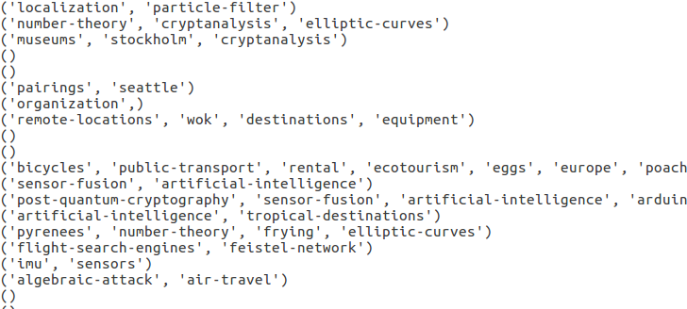

Slide 8
Binary Relevance with SGDClassifier
CountVectorizer for transforming the text content to vectors
MultiLabelBinarizer for transforming tags into vectors, a two way transformer gives actual tags when asked with input vectors
StochasticGradientClassifier, classifier for learning maxima / minima by iterations.
BinaryRelevance, a problem transformer, that transforms the multilabel classification into single label classification problem.
Small Data accuracy score : 0.5 -0.8
Full Data accuracy score : 0.1 - 0.2

Slide 9
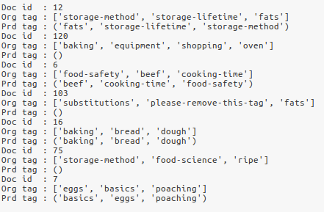

Slide 10
Multi-Label KNN Classifier
TfidfVectorizer to convert the text data into the CSR Matrix.
MultiLabelBinarizer to convert the tags data into binary sparse matrix.
Fit method takes CSR Matrix of train data and binary sparse matrix of the tag data to train the classifier.
Predict method takes CSR Matrix of test data and predicts the tags for each document based on the K nearest neighbors.
The ouput will be a sparse binary matrix that is converted to dense matrix and then label are fetched against each true value.
Accuracy comes out to be 0.4-0.6 on small data and 0.08-0.09 on full data

Slide 11
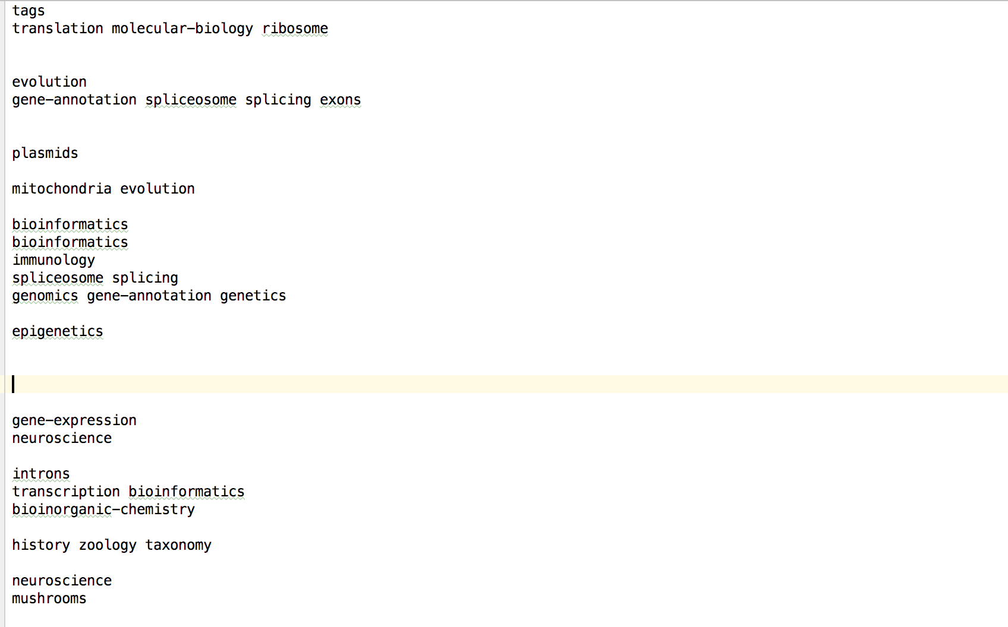

Slide 12
Comparison Of Results
Classification methods arranged based on the accuracy score:-
1. One vs Rest Classifier with Perceptron
2. Binary Relevance problem transformer with Stochastic Gradient Descent Classifier
3. Multi-Label KNN Classifier
Difference in preprocession techniques used :-
1. TfidfVecotrizer CountVectorizer
2. Varied classification results
3. MultiLabel Binarizer

Slide 13
References
Kaggle Problem - https://www.kaggle.com/c/transfer-learning-on-stack-exchange-tags

